Slide 1


Pigeon Farm
Midterm Presentation
2020.05.26

Slide 2
Part 1
Who are we
MENU
What we have done
Part 2
Part 3
What we are going to do

Slide 3
Part 1
Who are we

Slide 4






Team Built
https://vineash.github.io/JLU_DSD/
Jiayi Wang
PM
Alex Machado
Developer, Tester
Wanting Zhao
RA
Sara Nóbrega
Tester
Puli Wang
SA
Tiago Lima
SA, Developer

Slide 5
Part 2
What we have done

Slide 6
Modules
Database
  User
  GIS
  Wi-Fi
Algorithm
  Positioning
  Statistics
  Intermediate
Client
  Android/iOs
  Browser
Server
  Web service
  Pages
Map
  Import
  Draw
Wi-Fi Fingerprint
- Place
- Measure
- Upload

Slide 7
Timeline
Coding
May.8 - Now
Apr.24 – May.7
Testing
Apr.10 – Apr.23
Requirement
Analysis
System
Design
Mar.26 – Apr.9

Slide 8
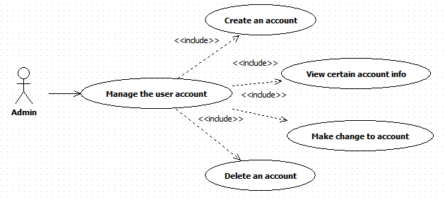
Requirement Analysis-External
Mar.26 – Apr. 9
Use Case: Admin manages the user account in Database
The administrator may want to operate user accounts at some point, for example:
Create an account
View certain account info
Make changes to certain account info
Delete an account, etc.
Return a value which may represent successfully create / create fail
List all the related information about the user in a clear way,
or return a NULL value.
Give admin the permission to modify user’s information,
and give feedback of result
Give admin the permission to delete items which are related to the certain user, and return the result of successfully create / create fail.

Slide 9
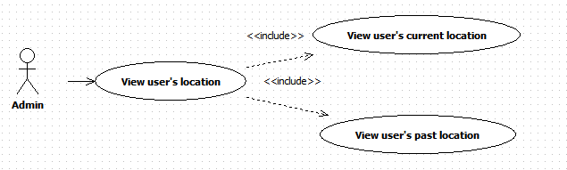
Requirement Analysis-External
Mar.26 – Apr. 9
Use Case: Admin views a certain user’s location information
The administrator may want to have an understanding of:
Where a certain user currently is
Where a certain user has been to during a period of time.
Represent a map including where the user is and his / her surrounding landmarks.
Ask the user which period of time the admin is going to look in.
If the time admin is enquiring is illegal, send admin an error message.
If there exists such kind of records, show it to admin in a clear way.

Slide 10
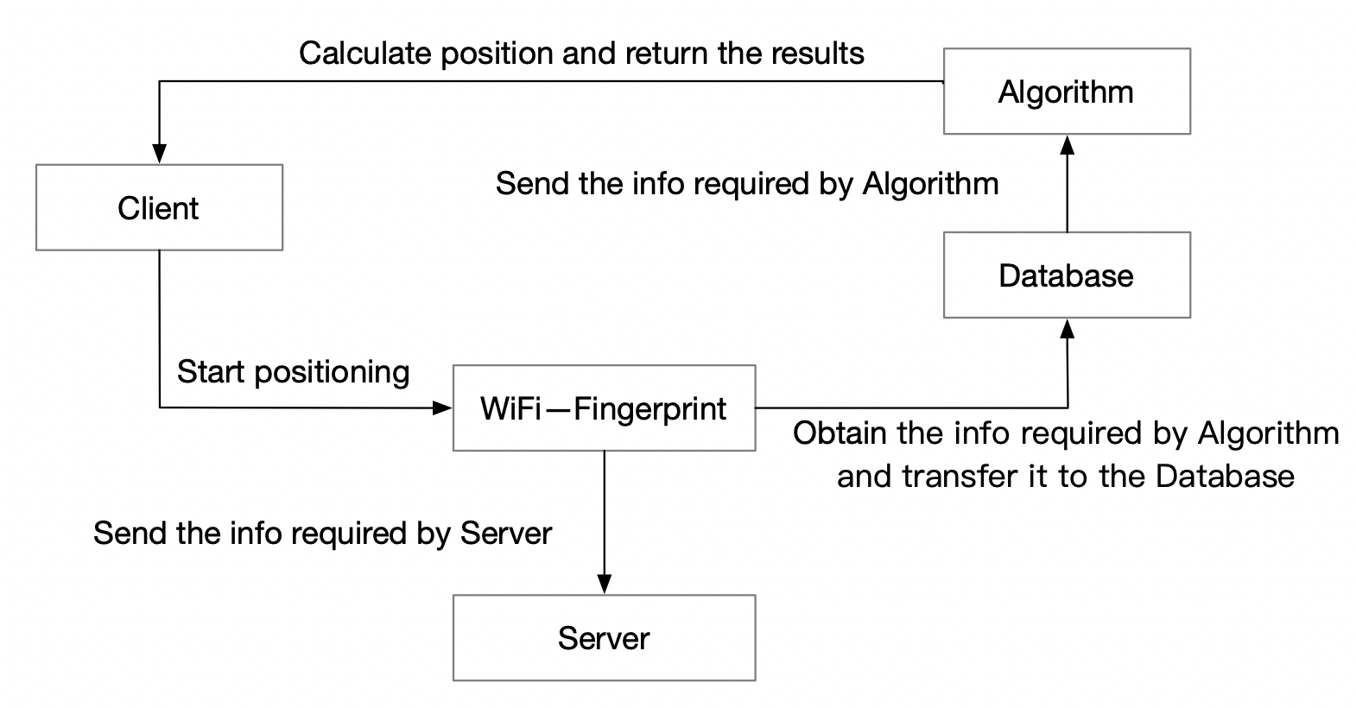
Requirement Analysis-Internal (WI-FI Fingerprint)
Mar.26 – Apr. 9
Modules which are related to Wi-Fi Fingerprint and the relationship between them.

Slide 11
Requirement Analysis-Internal (WI-FI Fingerprint)
Mar.26 – Apr. 9
Interact with two modules
Provide an interface for Module Client.
Provide an interface for Module Server.
Provide for | Trigger
Server | A user position requirement is activated
Client | The admin requires the current Wi-Fi Fingerprint

Slide 12
Requirement Analysis-Internal (WI-FI Fingerprint)
Mar.26 – Apr. 9
Aims of Module Wi-Fi Fingerprint are as follows:
Provide an interface for Module Client. Whenever a user position requirement is activated, get Wi-Fi Fingerprint information and return it, so that Module Client will be able to send it to Module Algorithm.
Provide an interface for Module Server. Whenever the admin requires the current Wi-Fi Fingerprint, get Wi-Fi Fingerprint information back to Module Server.

Slide 13
System Design
Apr.10 – Apr.23
Content
1、Software Specification Design (SDS)—WIFI fingerprint part
2、Interface Specification (IS)—WIFI fingerprint part
3、Integration of Interface Specification (IS)

Slide 14
1 Software Specification Design (SDS)—WIFI fingerprint part
1.1 Service Provided
Service | Provided By | Tested By
Get Current Wi-Fi Fingerprint | current_fingerprint | Client
Get Connection with Server and send | send_fingerprint | Server

Slide 15
1 Software Specification Design (SDS)—WIFI fingerprint part
1.2 Functions
current_fingerprint
send_fingerprint

Slide 16
1 Software Specification Design (SDS)—WIFI fingerprint part
1.2 Functions
Function Name | Parameters | Return Value | Called By
current_fingerprint | int areaID | [(MAC, signal strength), (MAC, signal strength), ... ((MAC, signal strength))] | Client(User wants to get current position)
send_fingerprint | [(MAC, signal strength), (MAC, signal strength), ... ((MAC, signal strength))] | true / false | Server(Admin wants to get current Wi-Fi Fingerprint)

Slide 17
1 Software Specification Design (SDS)—WIFI fingerprint part
1.3 Relations With Other Modules
Server
Client
Module | Way of Connection
Server | Based on WebSocket
Client | Based on Android Studio

Slide 18
1 Software Specification Design (SDS)—WIFI fingerprint part
1.4 Service Required
service from server
Service | Provided By
Client needs to provide username and password | Client

Slide 19
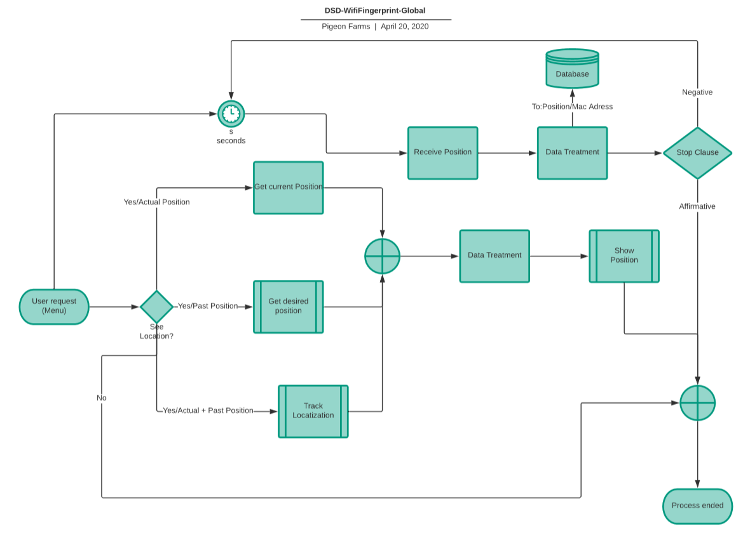
1 Software Specification Design (SDS)—WIFI fingerprint part
1.5 Flow chart--global

Slide 20
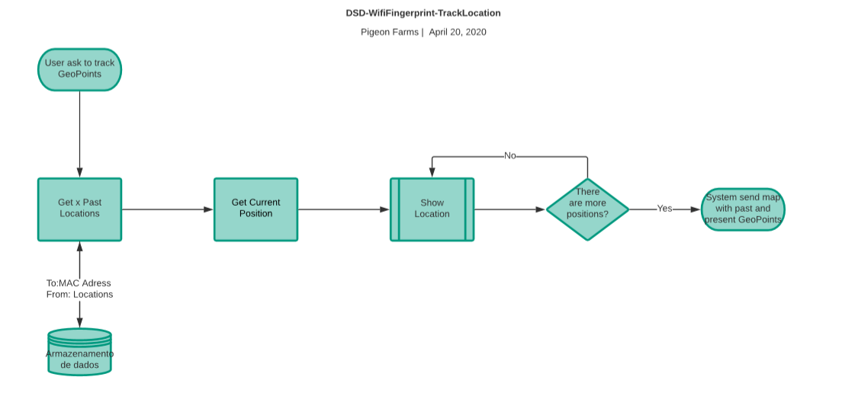
1 Software Specification Design (SDS)—WIFI fingerprint part
1.5 Flow chart—Track Location

Slide 21
2 Interface Specification (IS)—WIFI fingerprint part
2.1 Service Provided (mentioned)
2.2 Access Method (mentioned)
2.3 Access Method Effect
Access Method | Description
currentFingerprint | When the user wants to know his / her current position, he / she will operate on client. Then the client will call the method to get the current Wi-Fi fingerprint for positioning.
sendFingerprint | When the admin wants to get all the users’ current Wi-Fi information, he / she will operate on web for administration. Server will send us a signal when the admin starts to search for Wi-Fi information, then we will use this method to upload the current Wi-Fi fingerprint.

Slide 22
2 Interface Specification (IS)—WIFI fingerprint part
2.4 Service Required (mentioned)
2.5 Local Types
Type | Value Space
Fingerprint | A list of (MAC, signal strength) pairs.
2.6 Interface Design Issues
Which language will be used to get the Wi-Fi information?
Solution: Java.
How can we connect with module Server?
Solution: Websocket.

Slide 23
2 Interface Specification (IS)—WIFI fingerprint part
2.7 Test Cases
Step | Description | Input Type/Value | Expected Results | Service | Preamble
1 | To get the current Wi-Fi fingerprint | void | A list of Wi-Fi fingerprint information, such as: [(MAC, signal strength), (MAC, signal strength), ... ((MAC, signal strength))] | Java | 1

Slide 24
2 Interface Specification (IS)—WIFI fingerprint part
2.7 Test Cases
Step | Description | Input Type/Value | Expected Results | Service | Preamble
1 | To upload the current Wi-Fi fingerprint to server | A list of Wi-Fi fingerprint information / [(MAC, signal strength), (MAC, signal strength), ... ((MAC, signal strength))] | True / False represents the result of uploading. | Java | 2

Slide 25
Coding
Apr.24 – May.7
According to System Design, coding includes 2 parts:
Local fetching of Wi-Fi fingerprint
Upload Wi-Fi fingerprint to server through Websocket

Slide 26
Testing
May.8 - Now
Test period includes:
Unit Testing - ongoing
Unit testing is a test which is within our module Wi-Fi Fingerprint. To be more specific, tester needs to verify that whether internal requirements have been met.
  Can Wi-Fi fingerprint be detected and return correctly?
  If there is no Wi-Fi Fingerprint in the area where the user is, what the program should output?
Integration Testing - ongoing
Integration testing is a test which is between modules. Testers needs to test the interaction with module Client and module Server.
  Can Wi-Fi fingerprint successfully upload to server?
  If there is no Wi-Fi Fingerprint in the area, will a NULL value return to other module leads to any bug?
System Testing
System Testing is a test which includes all modules.

Slide 27
Testing
May.8 - Now
The framework we use is:
Mockito
JUnit

Slide 28
Part 3
What we are going to do

Slide 29
TO-DO
1. Upload Wi-Fi fingerprint to server through Websocket
  Interaction with module Server
  java.net.socket
  Socket.io
  Compatibility
  Fix it as soon as possible

Slide 30
TO-DO
2. Integration Test
Test between the modules that are relevant to us – Client & Server.
  Client:
    The transfer of username, password
    Whether client can get the fingerprint offline
  Server
    The upload of fingerprint

Slide 31
TO-DO
3. Discover errors and things that need improvement on the basis of the original version
SA 2.0
SD 2.0
Coding 2.0
Testing 2.0

Slide 32
Thank you for listening
Pigeon Farm - Midterm Presentation
2020.05.26

